Slide 1
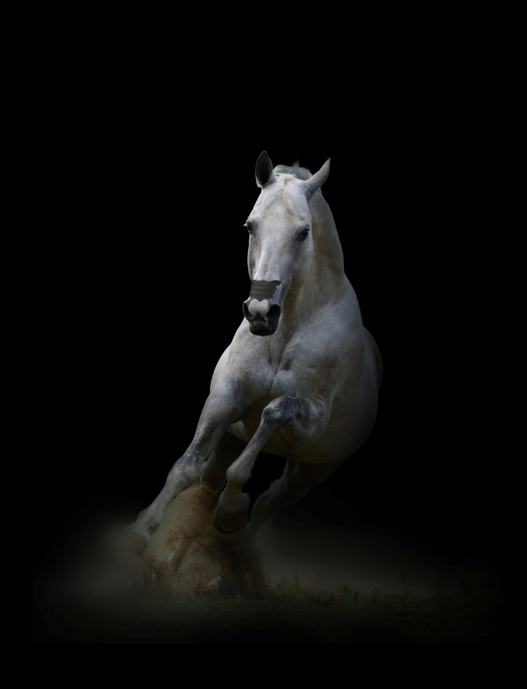

Breathing Easy: Relevancy of the science behind FLAIR® Equine Nasal Strips
Tammi S Epp, DVM, PhD, DACVSMR
2018 AAEP San Francisco, CA
December 3, 2018

Slide 2
PURPOSE OF TALK
How FLAIR works
2 primary factors involved in EIPH
How FLAIR reduces EIPH
Controlled Laboratory Data supporting efficacy of FLAIR
Controlled Field Data supporting that FLAIR works
Anecdotal Benefits of FLAIR
Types of horses FLAIR benefits?
The bottom line

Slide 3
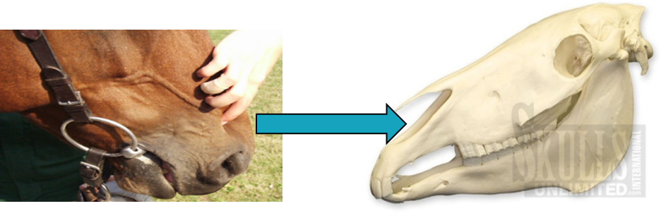
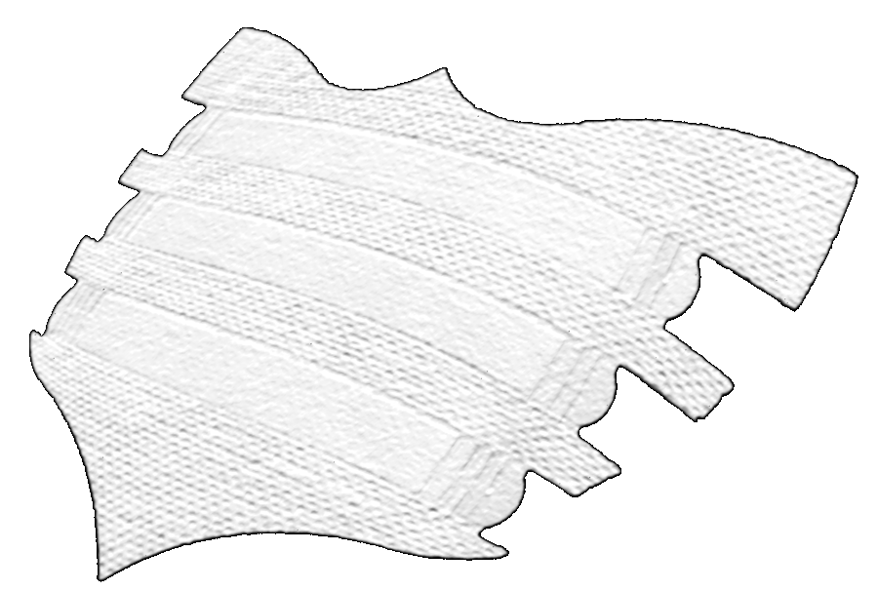
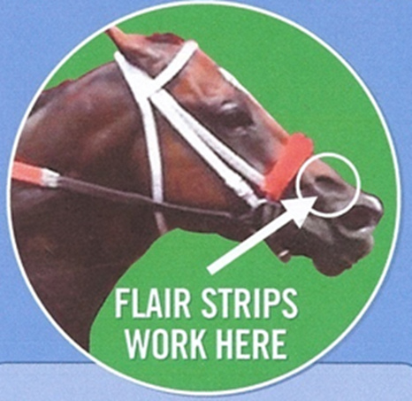
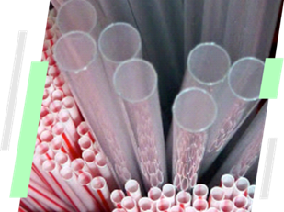
HOW
FLAIR® STRIPS
WORK
Spring Supports
Principle that FLAIR technology is based on:
Resistance of airway related to airway diameter
Key point:
Small changes in radius of airway causes large changes in resistance to airflow
Notes:
Layout recommendation
West 1993 paper if large falls in alveolar pressure were caused by a high airway resistance (i.e. UAO), then relief of the obstruction may be expected to reduce the incidence of EIPH

Slide 4
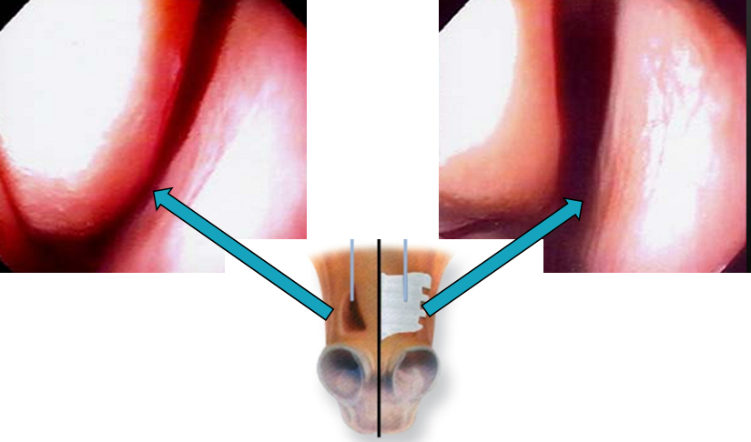
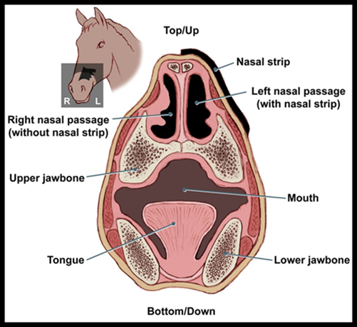
Effect of commercially available nasal strips on airway resistance in exercising horses
Holcombe, Berney, Cornelisse, Derksen & Robinson.
Michigan State University
AJVR 63: 1101-1105, 2002
Horses exercised at 100 & 120% HR_{max} with FLAIR:
  Endoscopic examination showed dilation of nasal valve while wearing Nasal Strip
Results in significant ↓ in:
  Peak tracheal inspiratory pressure
  Inspiratory airway resistance
Translates to ↓ pressure across blood-gas barrier

Slide 5
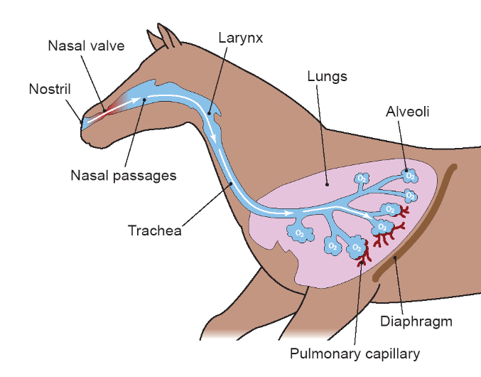
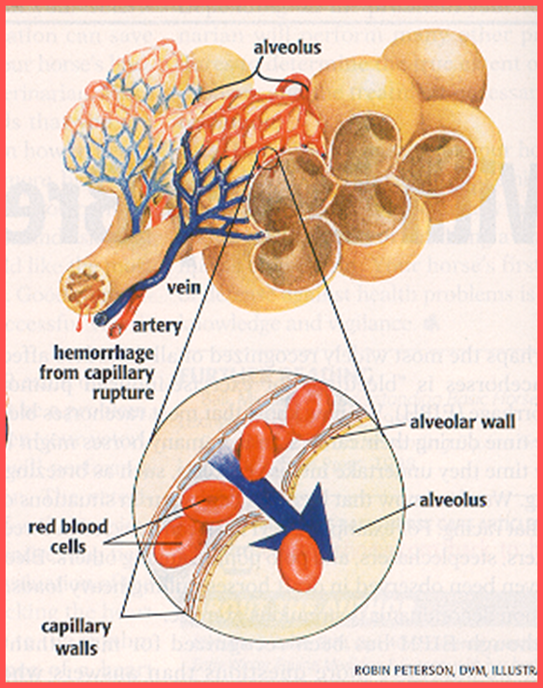
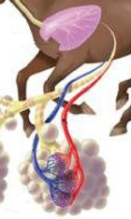
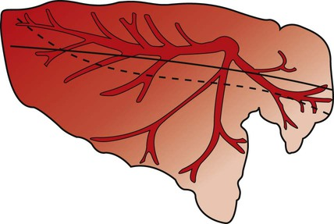
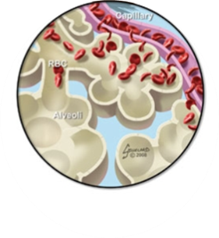
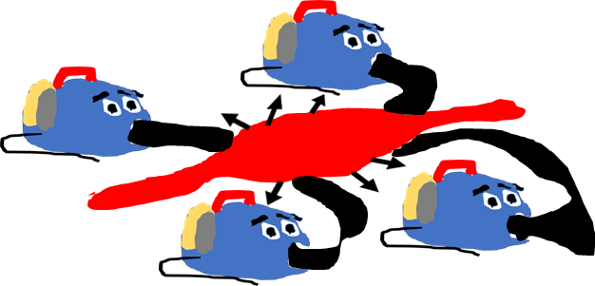
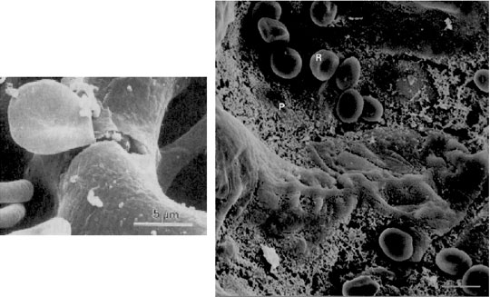
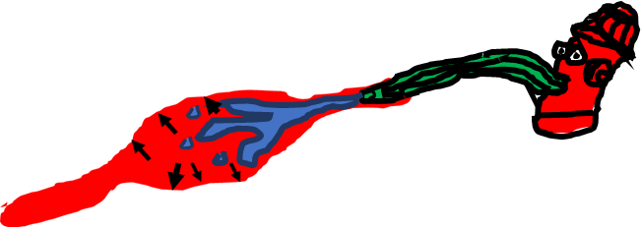
The 2 Major Forces Contributing to
Exercise-induced Pulmonary Hemorrhage
+
=
Extravascular Forces
Erickson et al. 1997
Intravascular Forces
Fu et al. 1992
Pulmonary Capillary
Pulmonary Capillary
RBC’s in alveoli
RBC escaping from pulmonary capillary into alveoli
Strong “vacuum-like” pressures created during inspiration result in extremely negative intrapulmonary and alveolar airway pressures
Stress Failure of Pulmonary Capillaries and Rupture of Vessels
Pulmonary Hypertension

Slide 6
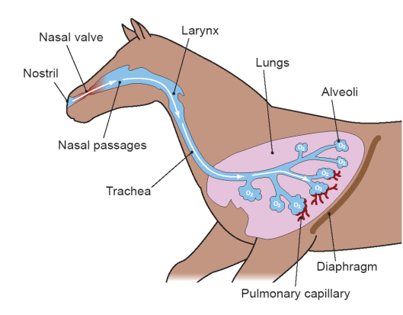
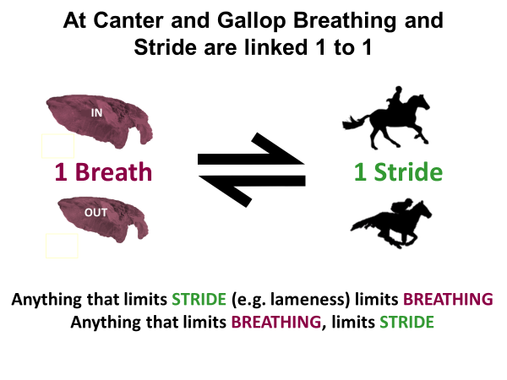
Causes of Negative Extravascular or “Airway” Pressures
Obligate nasal breathing
1.
3.
Extremely long trachea that contributes 25-40% of additional extrathoracic total inspiratory airway resistance of 80-90%
Visible dynamic collapse of soft tissues rostral to nasoincisive notch or “nasal valve” area
Nasal resistance during exercise is >50% of total inspiratory resistance
4.
Airway resistance doubles during exercise, requiring respiratory muscles to work harder and use up to 10-15% of cardiac output
2.
5.
Upper airway dysfunction (LH, DDSP, EE, NPC contribute to increased airway resistance and negative inspiratory pressures
Less than ¼ sec for inhalation (120-140 bpm)

Slide 7
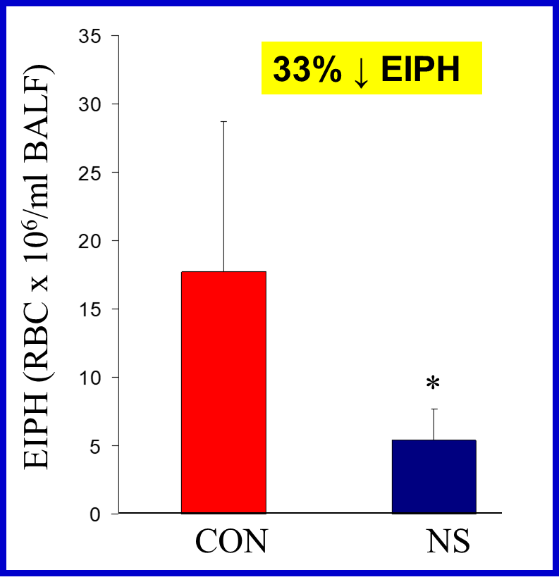
Effects of External Nasal Support on Pulmonary Gas Exchange and EIPH in the Horse
Poole, Kindig, Fenton, Ferguson, Rush & Erickson
JEVS 20: 579-585, 2000
Incremental exercise test (1 m/s increments) to mean speed of 27 mph on level treadmill with bronchoalveolar lavage (BAL) 30 minutes post-exercise
Range in bleeding reduction was 22-79%
Horses that evidenced greatest EIPH without nasal strip, elicited most substantial reduction while wearing nasal strip
Conservation of respiratory muscle energy & easier breathing
  5-6% ↓ whole body VO₂ at highest running speed
  Attributed to ↓ work by respiratory muscles due to ↓ inspiratory resistance and tracheal pressures

Slide 8
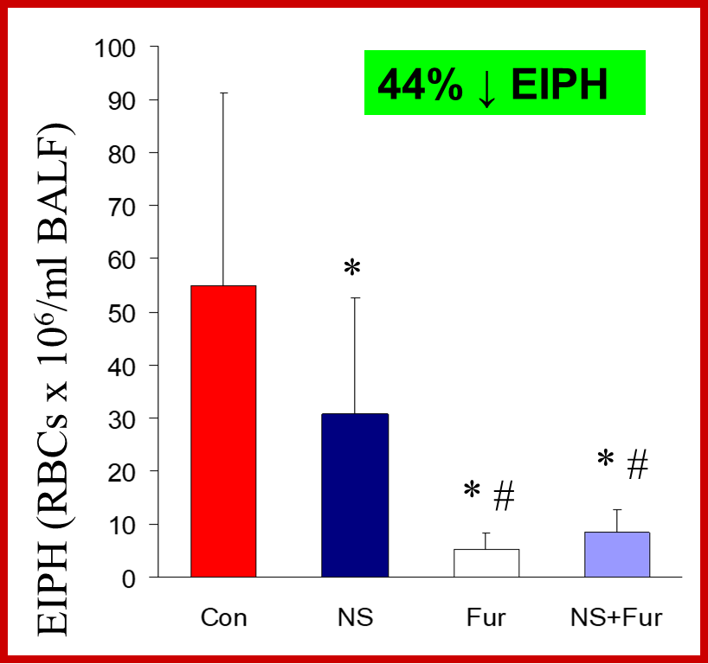
REDUCES
EIPH CONTINUED…
Efficacy of nasal strip and furosemide in mitigating EIPH in Thoroughbred horses
Kindig, McDonough, Fenton, Poole & Erickson JAP 91: 1396-1400, 2001
Incremental exercise test (1 m/sec increments) to mean speed 31 mph on level treadmill with BAL 30 min post-exercise
Neither FUR nor NS abolished EIPH
FUR (90% reduction) & NS (44% reduction)
Slightly greater ↓ EIPH with NS & ↑ speed
FUR+NS appears to offer no further ↓EIPH
Greatest benefit afforded to worst bleeders with NS
Treatments
Notes:
However, as we will discuss, field studies yielded different results.”

Slide 9
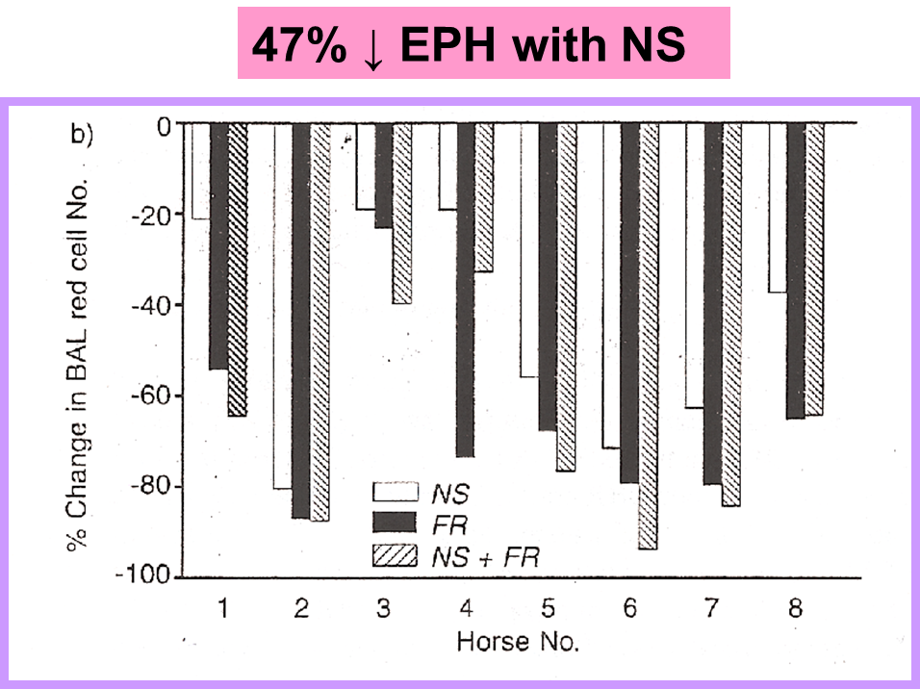
Effects of an External Nasal Strip and Frusemide on Pulmonary Haemorrhage in Thoroughbreds following High-intensity Exercise
RJ Geor, L Ommundson, G Fenton, and JD Pagan
Kentucky Equine Research
EVJ 33: 577-584, 2001
47% ↓ EIPH with NS
Exercise 2 min on incline at 31 mph with BAL 30 min post-exercise
Significant ↓ in EIPH with both NS and FR & additional benefit not apparent with FR+NS combination
NS ↓ metabolic cost of supramaximal exercise by 6% in agreement with Poole et al.
Horses demonstrating greatest EIPH without NS evidenced most substantial ↓ in EIPH with NS
Treatments
Notes:
However, as we will discuss, field studies yielded different results.”

Slide 10
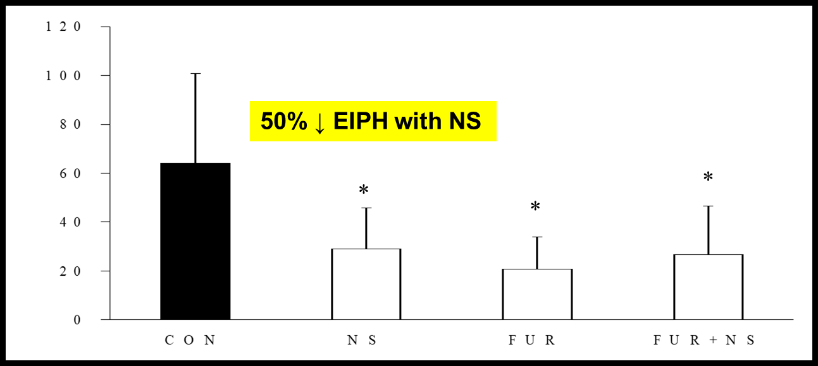
Effect of Furosemide and the Equine Nasal Strip on EIPH and Time-to-Fatigue in Maximally Exercising Horses
McDonough, Kindig, Hildreth, Padilla, Behnke, Erickson, and Poole
ECEP 1:177-184, 2004
Incremental exercise (1 m/s increments) on level treadmill to volitional fatigue with BAL 30 minutes post-exercise
Effectiveness FUR in EIPH ↓ diminished with ↑ exercise intensity (90% vs 50%)
NS and FUR ↓ EIPH to similar degree
NS, FUR, and NS+FUR ↑ Time-to-Fatigue over CON by 20 sec, 28 sec, and 40 sec respectively with no significant difference between treatments
NS maintained and ↑ effectiveness in EIPH ↓ (vs FUR) over range of exercise intensities
EIPH (x 10⁶ cells/ml BALF)
Notes:
“In contrast to other studies, in this studies horses were allowed to increase exercise intensity to volitional fatigue and here there was no difference in the benefit between FUR and NS.”

Slide 11
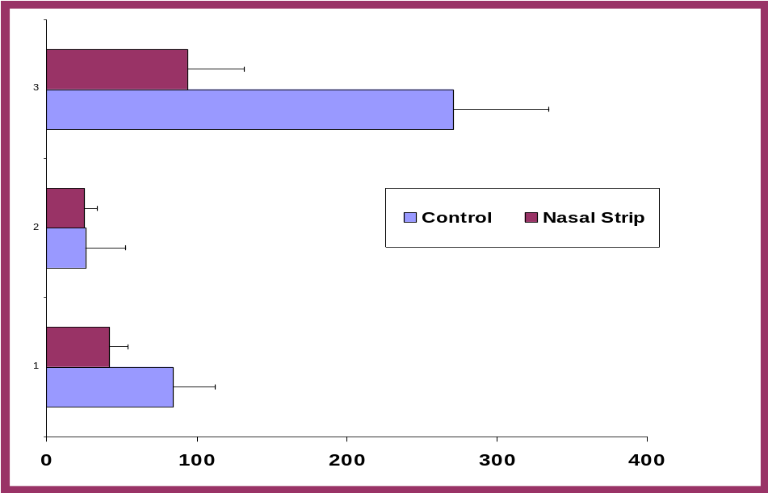
Effect of an external nasal dilator strip on cytologic characteristics of bronchoalveolar lavage fluid in Thoroughbred racehorses
Valdez, Nieto, Spier, Owens, Beldomenico, and Snyder
JAVMA 224: 558-561, 2004
Field study with 23 Thoroughbred Racehorses treated with Lasix + Nasal Strip during actual races
BAL 18-24 hours post-race (justification RBC shown not to change 5d so similar to 90 min post-exercise)
Results corroborated controlled treadmill laboratory studies
FUR+NS combination demonstrated synergistic EIPH ↓
***The most severe bleeders afforded the most benefit by showing the greatest ↓ in EIPH when wearing the Nasal Strip
Heavy Bleeders With Nasal Strip
* 93.8 cells/µL
Heavy Bleeders Without Nasal Strip
271.0 cells/µL
Mild Bleeders With Nasal Strip
25.4 cells/µL
Mild Bleeders Without Nasal Strip
26.3 cells/µL
* Denotes significantly different versus control for particular group of horses
Mean of All Horses With Nasal Strip
  41.7 cells/µL
Mean of All Horses Without Nasal Strip
  84.6 cells/µL
# RBC’s/µL BAL Fluid

Slide 12
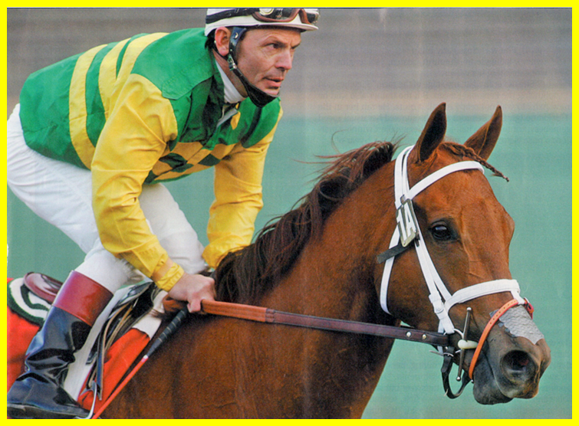
QUICKENS
RECOVERY
Scollay Field Study 1999-2000
Erickson HH, Epp TS, and Poole DC
AAEP Proceedings 53: 68-71, 2007
400 horses at Calder Race Course in Miami, Florida
Horses wearing FLAIR had a win percentage 3.4% higher than horses not wearing strip
15% decrease in interval to next race (23 days) compared to race interval prior to wearing FLAIR (29 days)
Notes:
Layout recommendation

Slide 13
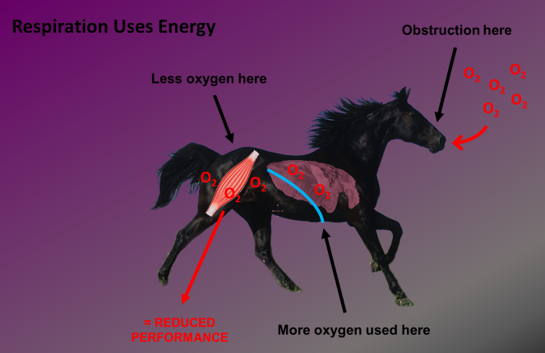
ANECDOTAL
BENFITS
Aids recovery from upper airway surgery
Horses with upper airway dysfunction (DDSP, LH, EE…)
Human studies and horse owners report, enhanced focus & relaxation and ↓ perceived exertion
Horses of ↓ athletic ability and/or unfit horses (i.e. Holcombe et al. study horse ran only 25 sec without NS and 45 sec with even though did not finish exercise test)
May impact stride efficiency by ↓ airway resistance so horses can take longer strides and deeper breaths
Notes:
Layout recommendation

Slide 14
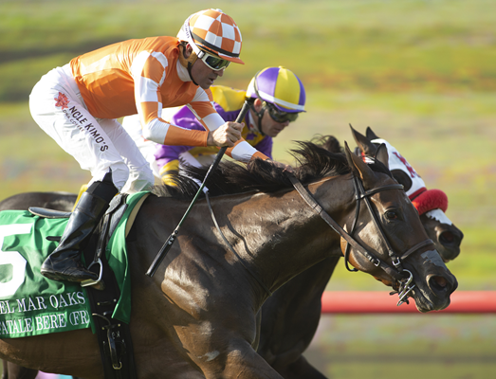

ANECDOTAL
BENFITS CONTINUED…
Drug-free alternative with no adverse effects & maintains effectiveness with long-term and repeated use unlike Lasix
Faster recovery – respiratory rate post-exercise driven by temperature & FLAIR allows faster cooling due to ↑airflow across blood vessels in upper airways
If used during training may ↑ career longevity since 80% of horse’s career spent in training
Benefits endurance horses since research has shown that EIPH occurs during low intensity exercise
May be critical component of necessary combination therapy for EIPH (FUR+NS+concentrated equine serum (mitigates inflammation) demonstrated 75% reduction in EIPH)
Notes:
Layout recommendation

Slide 15
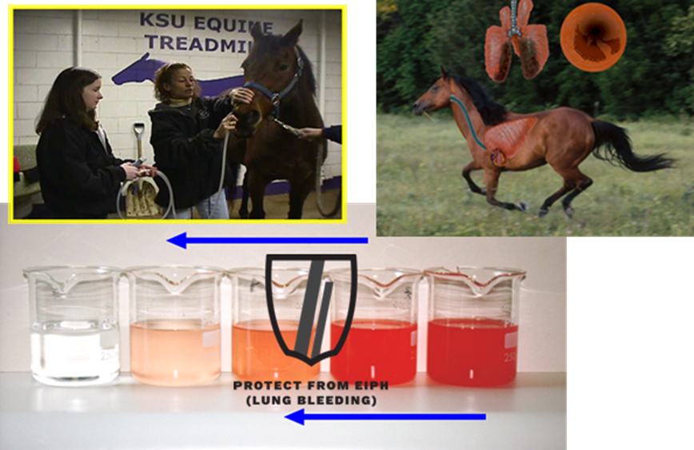
THE
BOTTOM LINE
The most severe bleeders show the largest ↓ in EIPH
Increasing effectiveness as exercise intensity ↑
Equivalent to Lasix in ↓ EIPH at maximal effort
Lasix + Nasal Strip are synergistic in EIPH ↓
Notes:
Layout recommendation

Slide 16
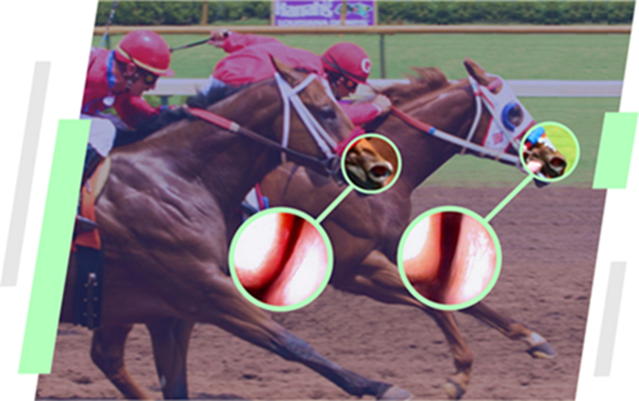
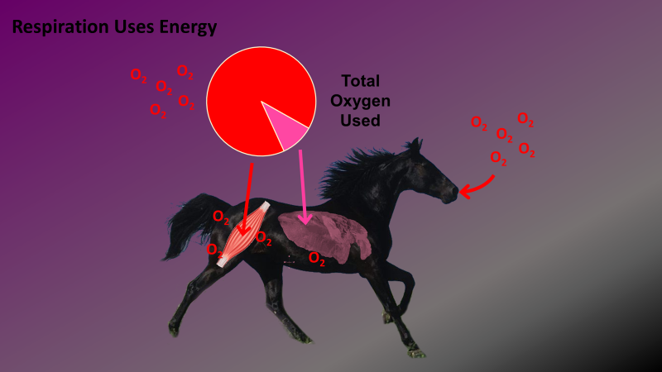



THE
BOTTOM LINE
CONTINUED…
Without FLAIR
With FLAIR
FLAIR allows horses to breathe easier by supporting nasal airway
FLAIR reduces extravascular (airway) forces to ameliorate EIPH
FLAIR lightens work load on respiratory muscles and conserved blood flow & oxygen is shunted to locomotory muscles to ward off fatigue which allows horses to run longer
Notes:
Layout recommendation

Slide 17
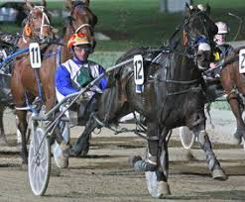
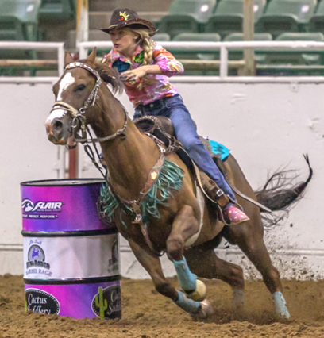
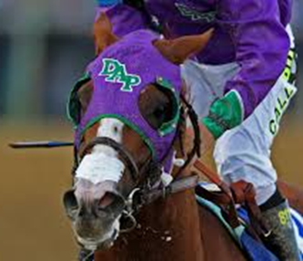
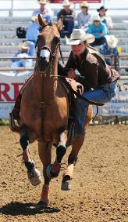
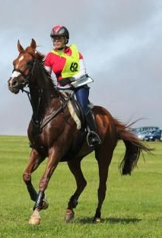
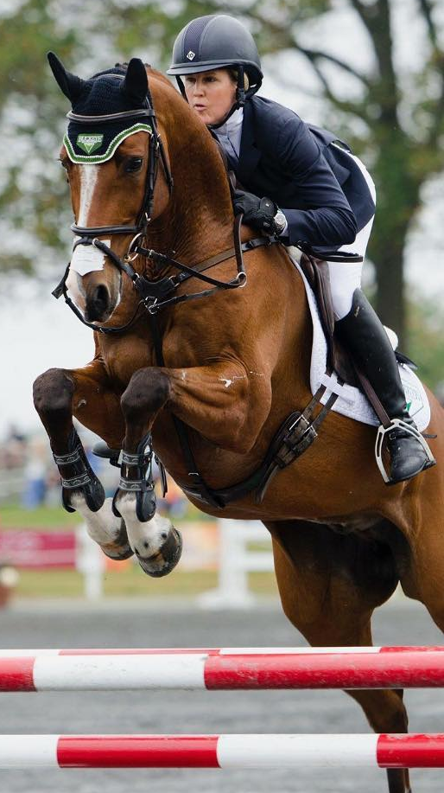
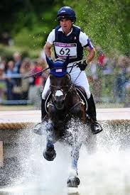
WHO BENEFITS
FROM FLAIR® STRIPS?
Horses Performing ANY Discipline at ALL Levels of:
Fitness, Ability, & Competition
Notes:
Backyard, fat vs fit

Slide 18
Thank you
FLAIR Strips Optimize Health & Performance
and
Inclusion Should be Considered a part of the Overall Health Program

